Slide 1
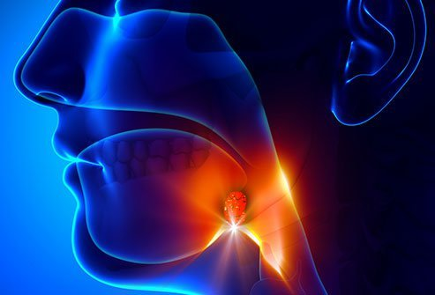
pharyngitis
Name
Instructor
Course
Date

Slide 2
Pathophysiology
Bacteria pharyngitis pathogenesis differs with etiology
Streptococcal pharyngitis, the most common, releases bacteria proteases and exotoxins
Scarlatiniform exanthem development is a result of erythrogenic exotoxins (Wolford et al., 2018)
Valvular heart disease and rheumatic fever may result due to a reaction between m2-protein of the myocardial tissue and secondary antibody
On the other hand, acute post streptococcal glomerulonephritis can occur due to the complexing of the antigen-antibody

Slide 3
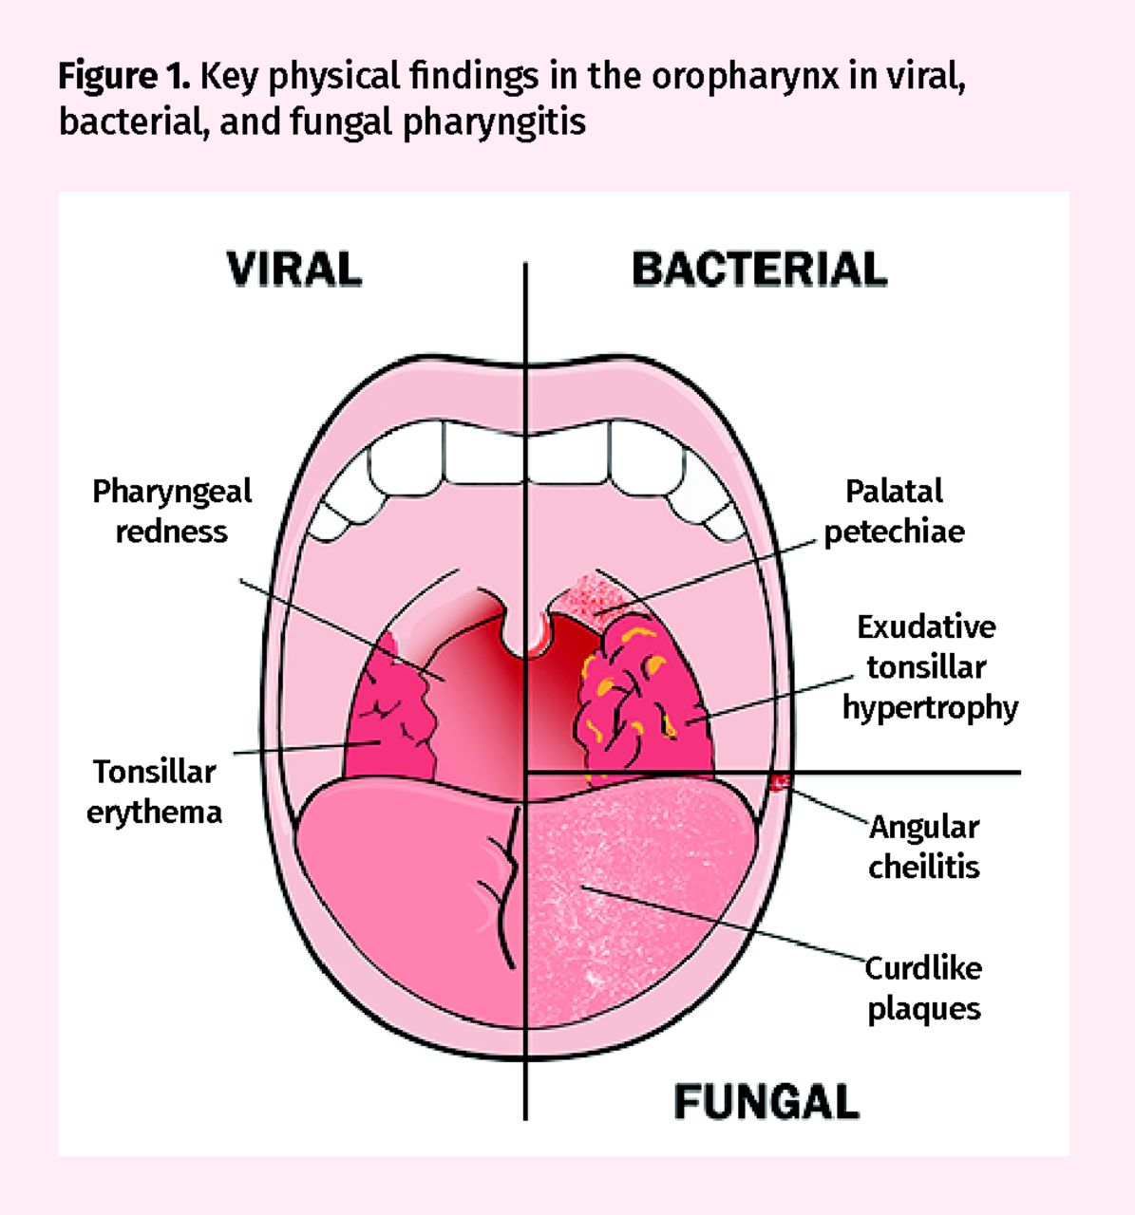
Cause
Various bacterial and viral agents that cause
pharyngitis include;
Chickenpox
Whooping cough
Croup
Group A streptococcus
(Harberger & Graber, 2020)
Adenovirus
Group A streptococcus causes strep throat infection
Other causes of bacterial pharyngitis are chlamydia,
gonorrhea and corynebacterium

Slide 4

Diagnosis
Physical examination to check current symptoms such as nose, ears and throat for infection (Harberger & Graber, 2020)
If no sign of viral infection, there is likely no further testing
Throat culture helps to confirm a bacterial infection
Blood test

Slide 5
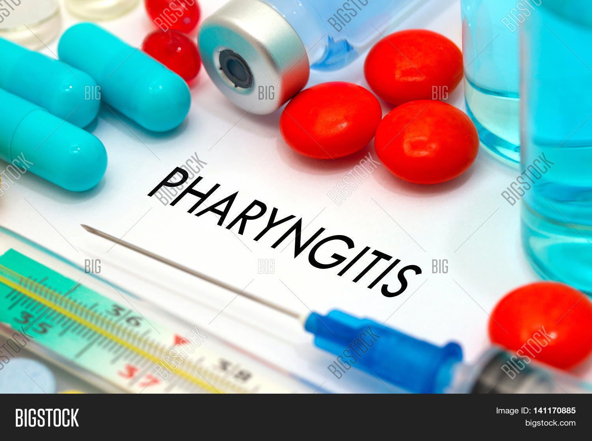
Treatment
Use of oral antibiotics
Examples include amoxicillin or penicillin (Wolford et al., 2018)

Slide 6
Prevention
Maintaining hygiene
Not sharing drinks, food and eating utensils
Keeping a distance from infected persons
Washing hands immediately after eating (Wolford et al., 2018)
Keeping away from secondhand smoke
Using alcohol based hand sanitizer when soap is unavailable

Slide 7
References
Harberger, S., & Graber, M. (2020). Bacterial Pharyngitis. StatPearls [Internet].
Wolford, R. W., Goyal, A., SY, B. S., & Schaefer, T. J. (2018). Pharyngitis.

